Slide 1

CGB1201 – JAVA PROGRAMMING
Department of Artificial Intelligence and Data Science
Academic Year: 2024 – 2025 (Odd Semester)
Register Number : 2303811724322040
Name : JANAKIRANI V
Year : II
Semester : III
Section : A
Date : 07/12/2024

Slide 2
SUPERMARKET BILLING SYSTEM

Slide 3
Problem Identification
Transaction Management Issues
Slow checkout process: Manual billing can lead to long queues, errors, and delays, impacting customer satisfaction.
Limited payment options: Lack of support for various payment methods (e.g., credit/debit cards, digital wallets) can inconvenience customers.
Inventory Management Challenges
Stock shortages: Difficulty in tracking real-time stock levels can result in frequent stockouts of popular products.
Overstocking: Poor stock monitoring can lead to excess inventory, increasing storage costs and risk of spoilage for perishable goods.
Customer Relationship Gaps
Lack of loyalty features: Absence of features like loyalty points or personalized offers can reduce customer retention.
Minimal customer data: Failure to collect and analyze customer data for better service and marketing strategies.

Slide 4
Objective
The primary objective of the supermarket billing system is to automate and streamline the billing and inventory management processes in retail environments. By replacing manual methods, the system aims to enhance operational efficiency, reduce errors, and speed up customer checkout. It provides role-based access for administrators, data entry operators, and billing operators to ensure secure and focused functionality. Administrators can define and manage taxes and commissions, track sales, and generate detailed reports to analyze store performance. The system also facilitates accurate inventory management by maintaining up-to-date product details, including stock levels and expiry dates.

Slide 5
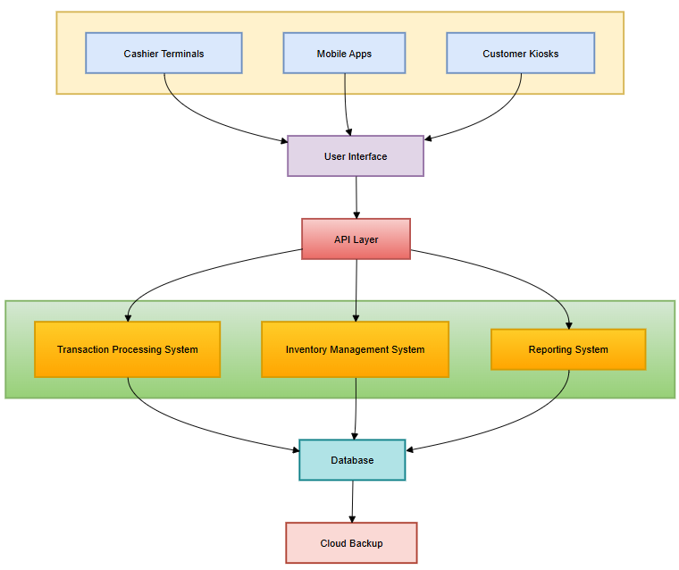
Proposed Architecture

Slide 6
Java Programming - Concepts Used
Object-Oriented Programming (OOP):
Classes and objects represent entities like products, customers, and invoices.
Encapsulation ensures secure access to class attributes using getters and setters.
Collections Framework:
ArrayList or HashMap is used to manage dynamic data such as product lists, inventory, or transactions.
File Handling:
Reading and writing data (e.g., product details and sales history) to files for persistence.
Exception Handling:
Using try-catch blocks to handle errors, such as invalid input or missing inventory, gracefully.
Input/Output Streams:
Scanner is used for user input, and classes like FileWriter or PrintWriter generate invoices or receipts.

Slide 7
List of Modules
Inventory Management Module
Product Purchase Module
Billing Module
Transactions Report Module
User Interface Module

Slide 8
Module Description
Module 1: Inventory Management Module
This module handles the initialization, storage, and management of product details, including name, stock, and price. It ensures accurate tracking of inventory levels and updates the stock automatically after transactions. Users can view the inventory for real-time stock information.
Module 2: Product Purchase Module
This module facilitates customer purchases by validating stock availability and deducting the purchased quantity from inventory. It calculates the total price for each transaction and ensures smooth handling of multiple product purchases in a session.
Module 3: Billing Module
The billing module generates a detailed bill for the customer, listing all purchased products, quantities, and their prices. It calculates the grand total and clears the transaction list after billing, ensuring a fresh start for the next customer.

Slide 9
Module Description (Cont..)
Module 4: Transactions Report Module
This module maintains a record of all transactions made during a session. It provides detailed reports of product purchases, quantities, and total prices, offering insights into sales and operational performance for better management.
Module 5: User Interface Module
The user interface module provides a menu-driven console interface, allowing users to navigate through the system. It accepts user inputs, routes them to the appropriate modules, and displays relevant information or results, ensuring seamless interaction with the system.

Slide 10
Source Code
import javax.swing.*;
import java.awt.*;
import java.awt.event.ActionEvent;
import java.awt.event.ActionListener;
import java.util.HashMap;
class Product {
String name;
int stock;
double price;
Product(String name, int stock, double price) {
this.name = name;
this.stock = stock;
this.price = price;
} }
public class SupermarketBillingSystemGUI extends JFrame {
static HashMap<String,Product> inventory = new HashMap<>();
private JTextArea inventoryArea;
private JTextField productField, quantityField;
private JTextArea receiptArea;
public SupermarketBillingSystemGUI() {
setTitle("Supermarket Billing System");
setSize(600, 500);
setDefaultCloseOperation(JFrame.EXIT_ON_CLOSE);
setLocationRelativeTo(null);
initializeInventory(); createUI();
}
private void createUI() {
// Layout
setLayout(new BorderLayout());

Slide 11
Source Code
// Top Panel for Title
JLabel titleLabel = new JLabel("Supermarket Billing System“,JLabel.CENTER);
titleLabel.setFont(new Font("Arial", Font.BOLD, 20));
add(titleLabel, BorderLayout.NORTH);
// Center Panel for Inventory
Display inventoryArea = new JTextArea(10, 40);
inventoryArea.setEditable(false);
JScrollPane inventoryScroll = new JScrollPane(inventoryArea);
add(inventoryScroll, BorderLayout.CENTER);
// Bottom Panel for Purchase Controls
JPanel bottomPanel = new JPanel();
bottomPanel.setLayout(new GridLayout(3, 2, 5, 5));
bottomPanel.add(new JLabel("Product Name:"));
productField = new JTextField();
bottomPanel.add(productField);
bottomPanel.add(new JLabel("Quantity:"));
quantityField = new JTextField();
bottomPanel.add(quantityField);
JButton purchaseButton = new JButton("Purchase");
JButton viewButton = new JButton("View Inventory");
bottomPanel.add(viewButton);
bottomPanel.add(purchaseButton);
add(bottomPanel, BorderLayout.SOUTH);
// Right Panel for Receipt
JPanel rightPanel = new JPanel();
rightPanel.setLayout(new BorderLayout());

Slide 12
Source Code
JLabel receiptLabel = new JLabel("Receipt", JLabel.CENTER);
receiptArea = new JTextArea(10, 20);
receiptArea.setEditable(false);
JScrollPane receiptScroll = new JScrollPane(receiptArea);
rightPanel.add(receiptLabel, BorderLayout.NORTH);
rightPanel.add(receiptScroll, BorderLayout.CENTER);
add(rightPanel, BorderLayout.EAST);
// Event Listeners
viewButton.addActionListener(e -> displayInventory());
purchaseButton.addActionListener(e -> purchaseProduct());
}
private void initializeInventory() {
inventory.put("Apple", new Product("Apple", 50, 0.5));
inventory.put("Banana", new Product("Banana", 100, 0.2));
inventory.put("Milk", new Product("Milk", 30, 1.2));
inventory.put("Bread", new Product("Bread", 20, 1.5));
}
private void displayInventory() {
inventoryArea.setText("");
inventoryArea.append("Product Name\tStock\tPrice\n");
for (Product product : inventory.values())
{
inventoryArea.append(String.format("%s\t%d\t$%.2f\n", product.name, product.stock, product.price));
} }
private void purchaseProduct() {
String productName = productField.getText().trim();
String quantityText = quantityField.getText().trim();

Slide 13
Source Code
if (productName.isEmpty() || quantityText.isEmpty()) {
product.name, JOptionPane.showMessageDialog(this, "Please enter both product name and quantity.", "Error", JOptionPane.ERROR_MESSAGE);
return;
}
if (!inventory.containsKey(productName)) {
JOptionPane.showMessageDialog(this, "Product not found in inventory!", "Error", JOptionPane.ERROR_MESSAGE);
return;
}
Product product = inventory.get(productName);
int quantity;
try {
quantity = Integer.parseInt(quantityText);
}
catch (NumberFormatException e) {
JOptionPane.showMessageDialog(this, "Invalid quantity. Please enter a number.", "Error", JOptionPane.ERROR_MESSAGE);
return;
}
if (quantity > product.stock) {
JOptionPane.showMessageDialog(this, "Not enough stock available!", "Error", JOptionPane.ERROR_MESSAGE);
return;
}
double totalPrice = quantity * product.price;
product.stock -= quantity;

Slide 14
Source Code
// Update Receipt
receiptArea.append(String.format("Purchased: %d x %s @ $%.2f each = $%.2f\n", quantity, productName, product.price, totalPrice));
// Clear input fields
productField.setText("");
quantityField.setText("");
}
public static void main(String[] args) {
SwingUtilities.invokeLater(() -> {
SupermarketBillingSystemGUI gui = new SupermarketBillingSystemGUI(); gui.setVisible(true);
});
} }

Slide 15
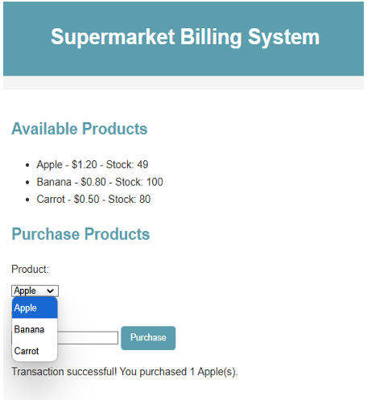
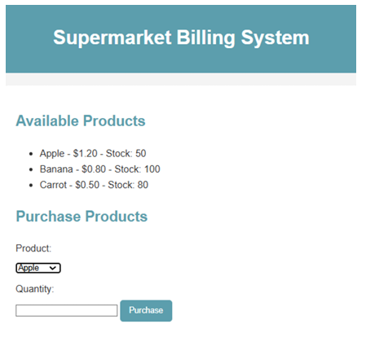
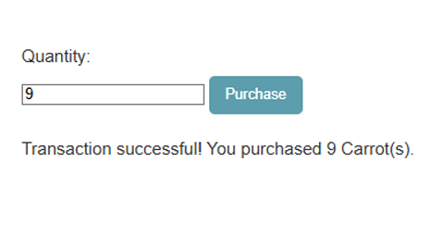
Results

Slide 16
Conclusion
The Supermarket Billing System is a robust and efficient solution designed to streamline daily operations in a supermarket. By integrating modules for user interaction, inventory management, billing, and reporting, the system ensures accuracy, scalability, and ease of use.
This project not only simplifies billing and stock tracking but also provides valuable insights through detailed reporting, enabling better decision-making for business growth. With proper implementation, this system can significantly improve operational efficiency, reduce human error, and enhance customer satisfaction.

Slide 17
Thank You
Any queries???

